Slide 1
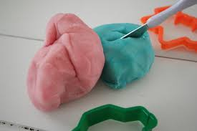
Entanglement
If 2 pieces of different colours of modeller wax are splashed together, they willl be entangled forever and you can’t tare them apart to the stage where You began

Slide 2
2 Classical bits
00 = 0
01 = 1
10 = 2
11 = 3
But what if we could handle a genuine imaginary number instead of stupid 1 and zeroes ?

Slide 3
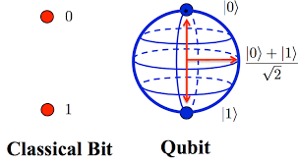
2 Qubits
Quantum bits is the answer to this problem
Qubits as they are called. can act as classical bits, but they can also handle information in the middle of between – The superposition
The number will act as a vector pointing in a direction on a marble

Slide 4
2 Qubits continued
Qubit 1 as a wavefunction: lφ> = (α0l0> + α1l1>)
Qubit 2 as a wavefunction: lψ> = (ß0l0> + ß1l1>)
Tensor prod. lω> = (α0l0> + α1l1>)⊗(ß0l0> + ß1l1>)
lω> = ( α0ß0l00> + α0ß1l01> + α1ß0l10> + α1ß1l11>
An entangled Bell state will be like :
lω> = ( α0ß0l00> + α1ß1l11>
The 4 states from point 3 are now entangled because you can’t go reverse from p.6 to p.3
This is only possible if α0, α1, ß0, ß1 differs from 0 so it must be somehow entangled

Slide 5
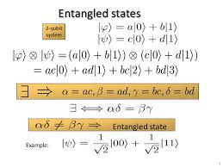

Slide 6
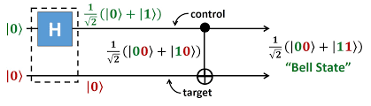
A grahical presentation by Quantum circuits
Show a grahical presentation on how a entangled state will be by a Hadamard and a CNOT gate.

